Slide 1
Presentation to the INTOSAI Working Group on IT Audit Systems assurance and data analytics for continued audit quality and improved efficiency of audits 18 April 2018

Slide 2
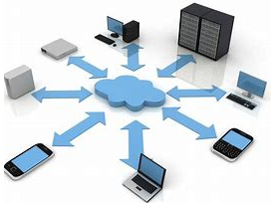
Public Sector: Drivers to change
Digital transformation of government information and services, making them simple, clear and fast.
Digital Transformation agenda
WoG ICT and procurement Strategies
WoG Platform Strategies
Other Reform Agendas
Program Management Strategy
Contestability Reform
Shared Services Reform
Public Management Reform
Data sharing between Government agencies
Public data policy

Slide 3
Audit Sector: Drivers to change
Response to external drivers
Increase in expectations
Increased assurance
Increased efficiencies
New technology and tools used at all layers in the IT Audit domain
Provide views on IT controls within and across agencies
Identify & evaluate quickly
Leverage technology & tools
Leverage our ‘Digital Natives’ – Linking analytical/critical thinking skills to higher IT capabilities, ability to collect, transform and provide insights through data analysis while have sound knowledge of the business environment in which we are auditing

Slide 4
IT Audit in the ANAO
The ANAO’s newly established Systems Assurance and Data Analytics (SADA) Group
Systems Assurance and Data Analytics
Organisational Change
Senior Executive Director Role
Data Analytics
Business plan
To deliver quality and create value as trusted IT audit and data specialists to enable our business groups to deliver higher quality with increased efficiencies.
Business Plan
Data Analytics Strategy
Capability Review
Financial statement audits (25,000 hrs)
Performance audits and Assurance reviews (5,000 hrs)
Data analytics-related work (5,000 hrs)
New areas of focus - Information reports and performance statements
SADA is currently split into two sections:
Systems Assurance, which includes the systems and controls work (ITGCs, applications and cyber security audits); and
Data analytics, which is currently involved both in supporting performance and financial audits, and in supporting the implementation of the Data Analytics Strategy

Slide 5
Systems Assurance and Data Analytics Group
Our purpose has been expanded to include …. contributing to the better use of technology and tools to deliver outcomes in the ANAO.
Systems Assurance and Data Analytics
Organisational Change
Senior Executive Director Role
Data Analytics
Business plan
Our priorities
Implement the new business model.
Continue to deliver high quality systems assurance and data analytics services.
Provide meaningful insight into audit products through the timely identification and communication of risks relevant to ANAO reports and Parliament.
Develop the ANAO Data Analytics Strategy.
Increase staff skills development in new technology and tools.
Business Plan
Data Analytics Strategy
Traditional areas of support
Financial statement audits
Performance audits and Assurance reviews
Data analytics-related
New or expanded areas of support
Advanced data analytics-related work
Information reports
Performance statements

Slide 6
Maintaining Quality
Our relationships
Parliament
Australian Government Entities
INTOSAI, PASAI, Australian Council of Auditors-General
Our people
Capability - now & the future
Best mix of skills – not just numbers
Training in technology and tools
Public sector audit
Private sector audit
Capacity to innovate
Our SADA business
Leveraging our unique position as Government auditors
Building capacity to be agile and flexible
External evaluation and review
Contemporising our work

Slide 7
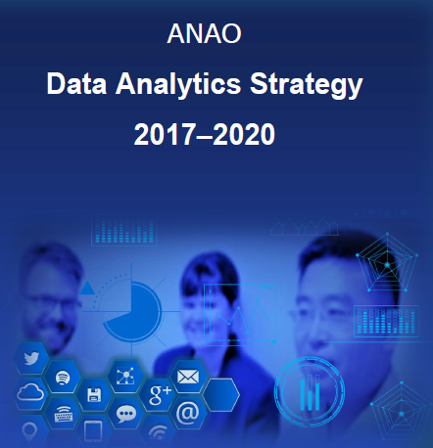
Audit quality in a digital world
Data Governance
Capture and secure
Use and share
Manage data
Objectives
A strategic framework for all data analytics work.
A governance framework that ensures that the implementation of data analytics is sustainable, maximises investment and integrates into the ANAO’s audit planning, execution and reporting processes.
Anticipate and respond to changes in how data and information is produced, collected and consumed.
Implement effective systems for collecting, classifying and interpreting data and information.
Provide technology systems and tools that enhance auditors’ skills and support data analytics research and innovation.
Provide a secure IT environment that ensures data privacy and integrity and mitigates security threats.
Embed into existing FS processes
Re examine traditional approaches
Ensure alignment to audit standards
Incorporated into workforce plan
Define our data universe
Re-design or re-align audit procedures
Embed across all audit & assurance activities
Leveraging our unique position as Government auditors
Building capacity to be agile and flexible
External evaluation and review
Contemporising our work

Slide 8
Data and Analytics ~ Quality and Efficiencies ~
Analytics-driven risk assessment
D&A enabled execution
Enhanced reporting
Audit scope and planning
Data aggregation & analysis that:
enhances risk identification in audit approach; and
informs risk selection across audit and assurance activities
Top down/Bottom up risk assessment and analysis
Data driven insights to assist in audit focus
Improved integration of data and analytics into risk assessment and audit procedure phases
Foster collaboration
Increase transparency and understandably in reporting
Increasing the reusability, sharing and understanding of available data

