Slide 1
IT Audit Capacity Building
A Country Report of SAI Indonesia

Slide 2
Introduction
Legal Framework
The 1945 Constitution
Resources
1 Headquarter Office
Law No. 15/2006 as in lieu Law No. 5/1973 about Supreme Audit Board
Law No. 15/2004 about Audit on Accountability of State Financial Management
34 Regional Offices (34 Provinces)
4700+ Auditors
50 Terabytes storage capacity
20Mbps Internet Bandwidth

Slide 3
Introduction
Information Resources
700+ Audit Entities has connected to BPK’s Data Center through e-Audit Program
Millions of records of State Financial Transactions; Central and Local Government

Slide 4
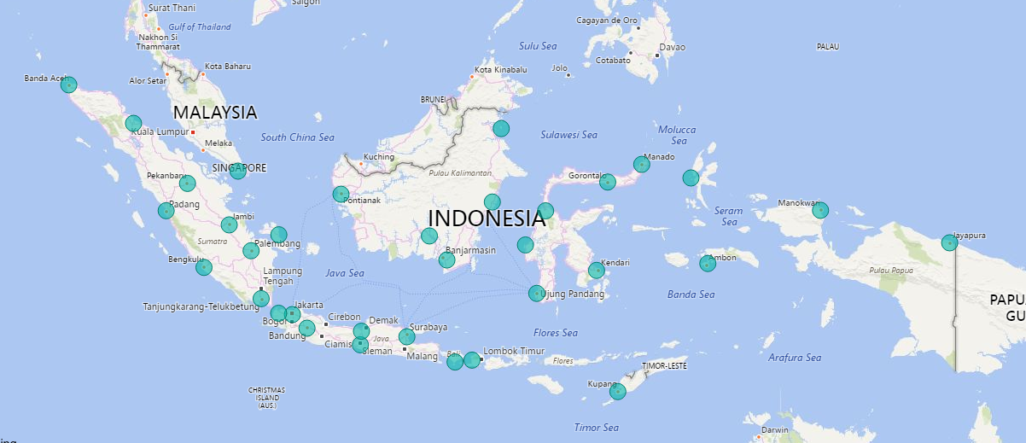
Introduction
34 Regional Offices of SAI Indonesia + 1 Headquarter Office in Jakarta

Slide 5
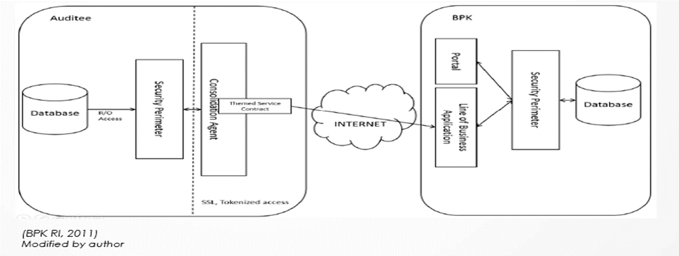
Introduction
Architecture of e-Audit System

Slide 6
Introduction
To make a more efficient and more effective Audit Process, IT Audit capacity improvement becomes a necessity for Supreme Audit Institution.
Since 2000, SAI Indonesia has modernized the Audit Process including the IT Audit Capacity Building

Slide 7
Components of IT Audit Capacity
People
Process
Technology

Slide 8
People
Volume
Increasing the CISA Holders
Knowledge
Training by local trainer
Training abroad, supported by other SAIs; SAI India and SAI Malaysia
From only 5 in 2000
Now 23 CISA holders 2017
Training on Digital Forensic

Slide 9
Process
Methodolody
IT Audit Guideline, based on ISSAI 5300
Organization
Establishing a unit under IT Bureau as a pool for IT Auditors
Specific IT Audit Handbook, based on WGITA – IT Audit Handook.
Creating an official job family namely “IT Auditor”

Slide 10
Technology
Infrastructure
Analytics Server
Tools
Generalized Audit Software
High Capacity Storage
ACL
IDEA
Customized Software
Analytics Dashboard
Automatic Analytic Procedures
Investigation Case Management System
Digital Forensic Software

Slide 11
Recent IT Audit Experiences
SAI Indonesia does not have experience in conducting IT Audit as a single IT Audit Assignment.
However, IT Audit in SAI Indonesia is always a part of three types of Audit according to Law; Financial Audit, Performance Audit, and Special Purpose Audit
IT Audit Objectives are aimed to support these global Audit Objective

Slide 12
Recent IT Audit Experiences
IT Audit as a part of Financial Audit
Audit on Central Government Financial Report, regularly since 2004
IT Audit as a part of Performance Audit
Audit on the implementation of Electronic ID Card (e-KTP), Ministry of Internal Affairs, 2016
Audit on Ministry of Information and Communication Financial Report, 2017
IT Audit as a part of Special Purpose Audit
Audit on the Citizenship Record Administration, Ministry of Finance, 2017
Audit on the implementation of e-Catalogue system, Government Procurement Policy Agency, 2017

Slide 13
Recent IT Audit Experiences
IT Audit Objectives in Financial Audit
Examining Data Integrity and Data Quality of Government Financial Information System
Cross-validating the Data across Audit Entities; Data from Ministry and Data from Ministry of Finance.
Examining the Government Financial Report-related Application Control
Providing other Auditors with a reliable data
Providing other Auditors with an automatic analytical procedures
The techniques are a CAAT on a Very Large Data Base (VLDB) infrastructure
Examining IT-related Procurement (Acquisition) in several Ministries.
158,611,418 records of National Accounting System, Ministry of Finance
140,305,202 records of Airline tickets from Garuda Indonesia, a flag carrier airline.

Slide 14
Recent IT Audit Experiences
IT Audit Objectives in Performance Audit on Electronic ID Card
Examining IT Operation of producing ID Card
Examining IT Procurement and Specification of hardware and software for acquiring biometric identity, recording identity, and printing the card
Examining IT Security of storing, accessing, and printing the electronic ID Card
Examining Software Development Process of Electronic ID Card System, including Biometric Recognition Software.

Slide 15
Recent IT Audit Experiences
IT Audit Objectives in Special Purpose Audit on e-Catalogue, Government Procurement Policy Agency
Examining the compliance of e-Catalogue system
Examining the Data Integrity of cataloguing and purchasing.
This audit implement an innovative audit techniques where auditors using web extraction technique to collect retailed price information from vendor’s website.

Slide 16
Conclusions
Information Technology grows very fast and more affordable for organization to take the benefit of IT.
Most Government Institution process financial transaction using Information System
Rely on printed document while the electronic form is available, is not efficient
Auditor should be able to access for interrogating the data
Supreme Audit Institution, as an organization with the intensive use of information, should now increase its capacity on IT Audit
Please be aware that the acceleration of IT Audit Capacity in SAI, to some extents, depends on the maturity of Auditee’s Information System as well.

Slide 17
Thank you

