Slide 1
Maintenance of IT Audit Database and Webinars
Notes:
NOTE:
To change the image on this slide, select the picture and delete it. Then click the Pictures icon in the placeholder to insert your own image.

Slide 2
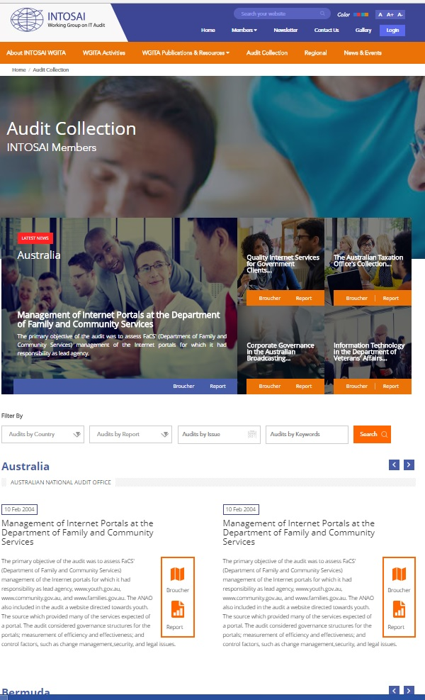
Database for IT audits
Structure proposed:
Title of Report – in original language and in English
Year of publication
Report languages
Functional area to which IT Audit pertains
Types of IT system
Short description of IT Audit
URL of report
URL of summary/highlights of report
PDF file of report
Tag words

Slide 3
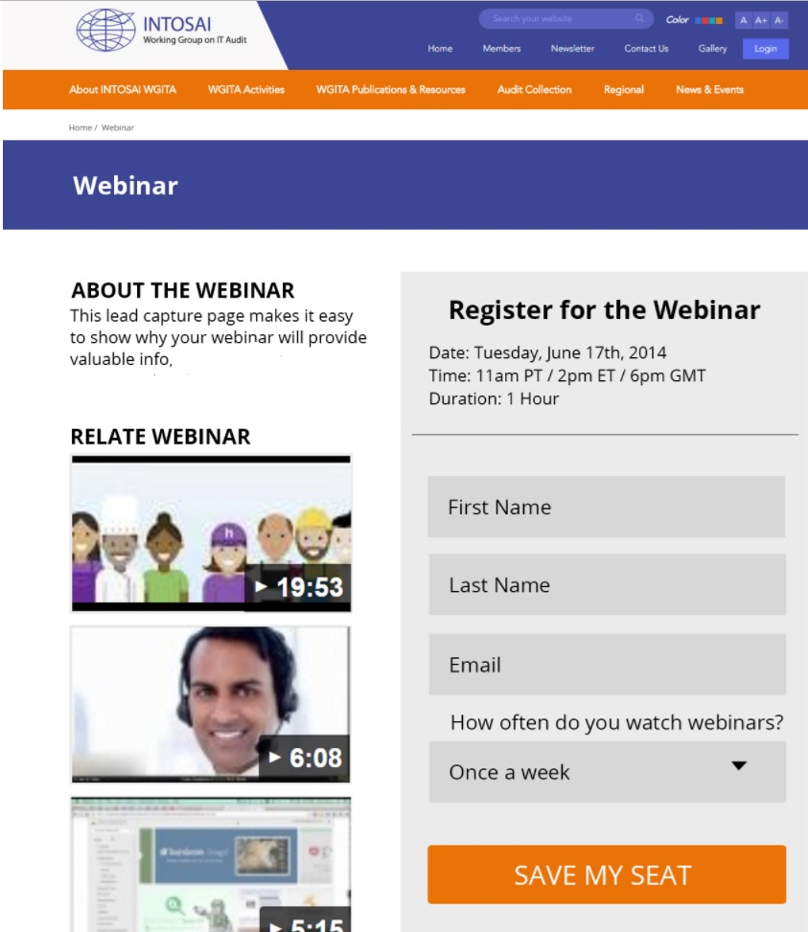
Webinars
Webinars an answer to increased aspirations of SAIs to present Country papers in Annual meetings
One webinar every six months
WGITA website would have facility to register for webinars

Slide 4
Issues for approval/discussion
Approval of
Template for collection of reports for audit database
Conduct of Webinar
Volunteers needed for
Collecting materials for audit report database
Conducting webinars

Slide 5
Thank You

