Slide 1
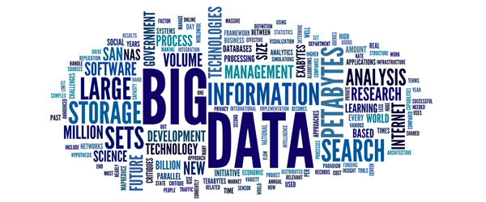
Opportunities and Challenges for Public Auditors

Slide 2
Big data
Big data – Large and complex data beyond the traditional capacities of IT infrastructure collated from all imaginable sources, which leverages Information as a vital asset.
Includes
Structured/unstructured data
Internal/external data
Formal and informal communication

Slide 3
Big data analytics
Big data analytics – Process of analysing big data with a view to discovering
Patterns
Correlations
abnormal behaviour and red flags

Slide 4
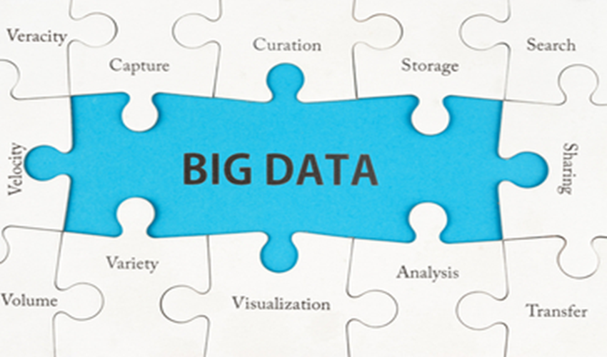

Slide 5
Opportunities - Technological explosion
Audited entities transitioning into virtual environments
Processes in real time
Storage, compute and connectivity – no longer limiting factors
Proliferation of Data Analytic tools

Slide 6
Opportunities -Transformational impact for Audit
Enables macro analysis at planning stage of entire data sets instead of a representative sample.
Enables digital auditing for
enhanced effectiveness and efficiency
Better detection of frauds, waste and abuse
Ushers in new age competencies
predictive analysis
advanced statistics

Slide 7
Opportunities- Aid to governance
Enables a proactive role for SAIs vis-a-vis executive and governance by.
Sharing big data
Sharing insights
Promoting transparency
Enhancing oversight

Slide 8
Opportunities- leveraging data assets
Data created by SAIs –internal databases and working papers audits etc
Data of audited entities –data collected from various audited entities
External data
Data/Reports published by Government
other data in public domain - surveys, bulletins information published by autonomous bodies etc.

Slide 9
Big data analytics- Challenges
Managing the people
Transforming the mindsets of auditors
Capacity building
Managing the data
Addressing sensitivities of access and usage of data
Addressing veracity of data from various sources
Privacy issues, legislative and regulatory compliance
Managing the IT infrastructure
Augmentation of appropriate infrastructure
Establishment of the technical solution

Slide 10
WGITAs role
Espouse - the goal of preparing the SAIs for auditing in the big data environment
Encourage - SAIs in establishment, implementation and maintenance of a robust governance framework
Provide - guidance on best practices to support SAIs to adapt audit design procedures and methodologies to the changing order of big data environment

Slide 11
WGITAs role
Practical guidelines could be provided to SAIs on
Digital auditing –preparing and developing mechanisms
Paradigm shift in data analytics –moving from representative samples to the whole data sets.
Guidance on data analytics – on usage of tools, risks involved, training infrastructure

Slide 12
Thank You

Slide 13
Initial endeavours - SAI India
Provided additional insights
Big data analytical tools enabled additional insights in the cash flow management by State Government involving
Exponential transactional level details of Treasury and RBI for analysing
Demand and supply mismatch of various departments
Idle cash and avoidable Government borrowings
Float time for disbursement – possible red flags/abnormal behaviour
Unreconciled cash balances of State Government vis-à-vis RBI balances

Slide 14
Initial endeavours - SAI India
Provided greater efficiency
Big data analytical tools enabled Audit planning and assessment of substantive testing from a centralised location in a case of presumptive fraud in employee payments involving
Volume – 5 million transactions over 18-36 months
Complexity – 30,000 field audit units, 35 Departments, 23 Districts and 256 Sub treasuries

