Slide 1
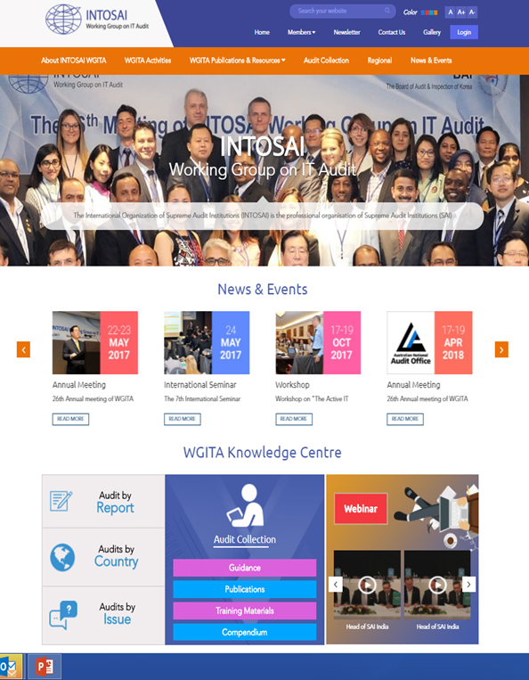
Revamped Wgita website – first look
Notes:
NOTE:
To change the image on this slide, select the picture and delete it. Then click the Pictures icon in the placeholder to insert your own image.

Slide 2
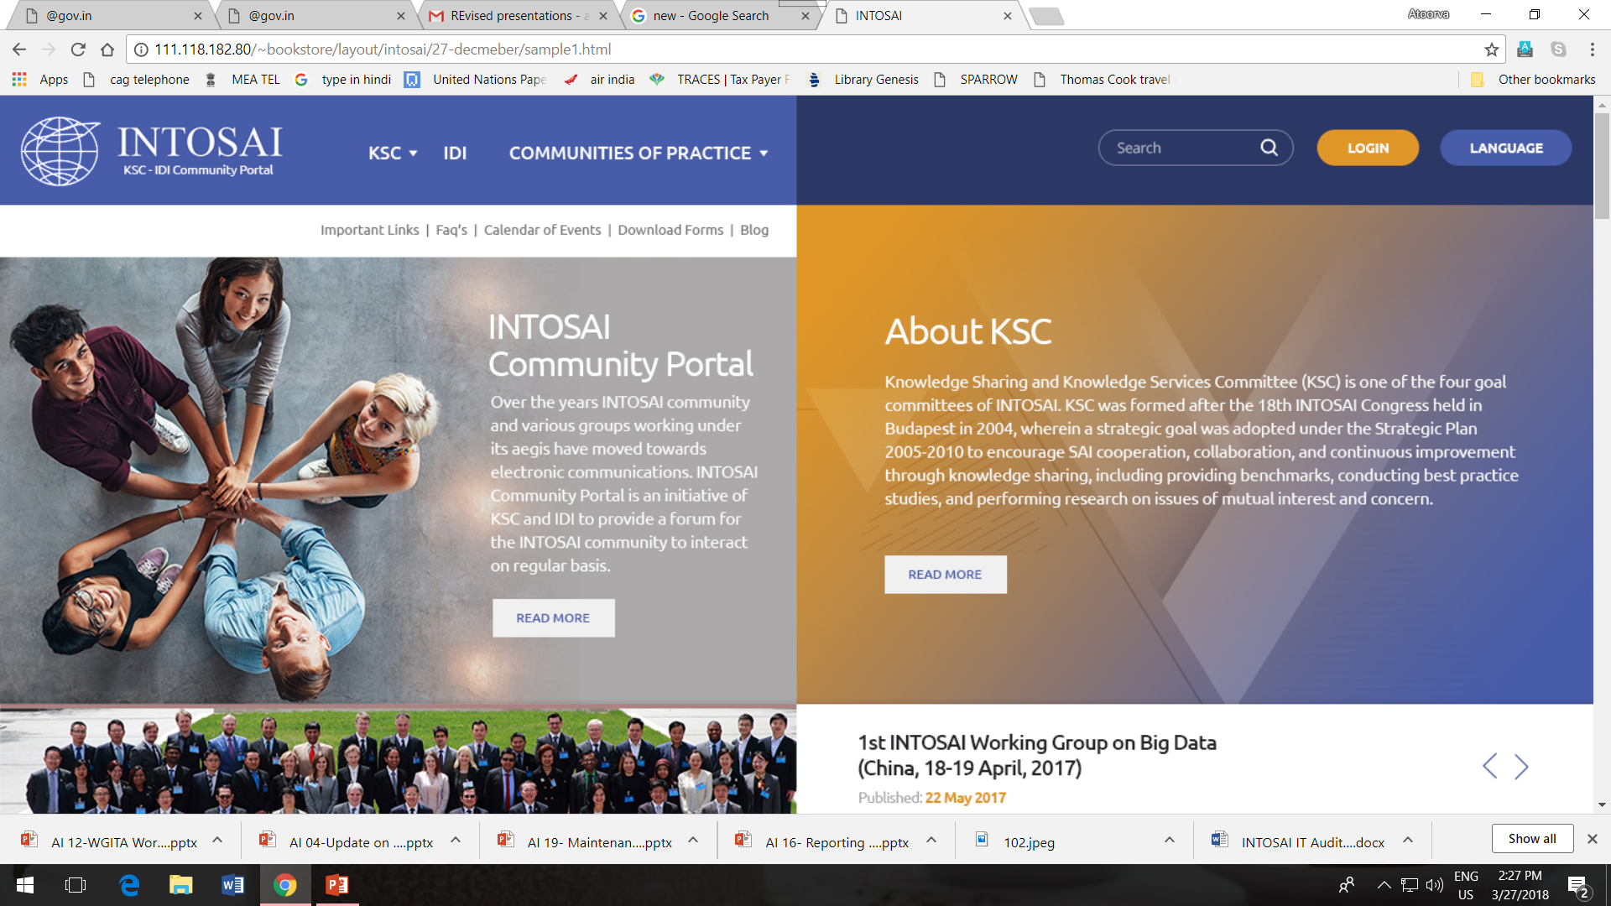
New INTOSAI Portal
SAI Malaysia managed WGITA website till now
Websites of all Working Groups of Knowledge Sharing Committee to be part of revamped INTOSAI Community portal

Slide 3
Salient Features of INTOSAI Portal
Earlier Portal
Revamped portal
Single Login
Single point of access for knowledge sharing
Consolidate webpages of all Working groups
Portability across devices
Available in all INTOSAI languages
Community of Practice with added features
Multiple 3rd Party utilities used
WG websites were not part of portal
Smartphone portability was unavailable
Only in English

Slide 4
Salient Features of INTOSAI Portal
Earlier Portal
Revamped Portal
Library had restriction on formats of documents
Auditor Centric
Questions & Answers
Best Practices
Audit report databases
Article from Heads of SAIs
Enriched Library
Blogs and Chats
In-built Video Conference facility with facility for recordings

Slide 5
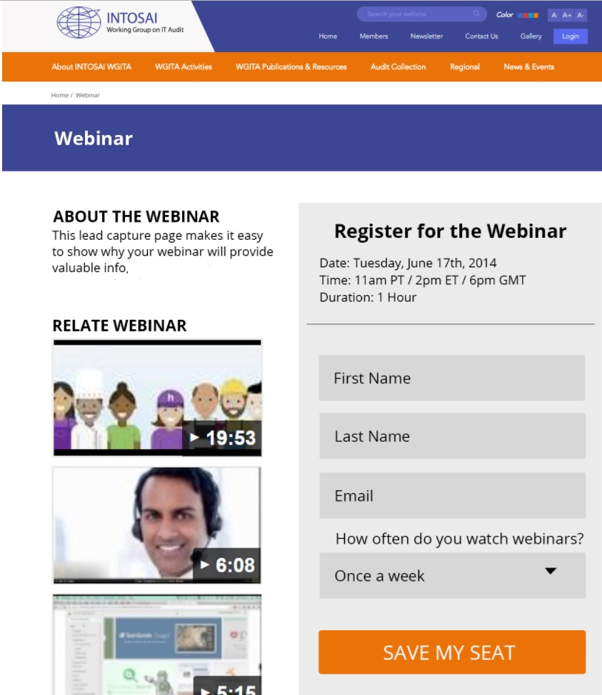
Salient Features of WGITA Website on Portal
Access features (except Webinar) without registration
Section on Knowledge Centre
Database of Audit Reports
Guidance
Publications and Compendium
Webinar
Multilingual
Community of Practice for WGITA members

Slide 6
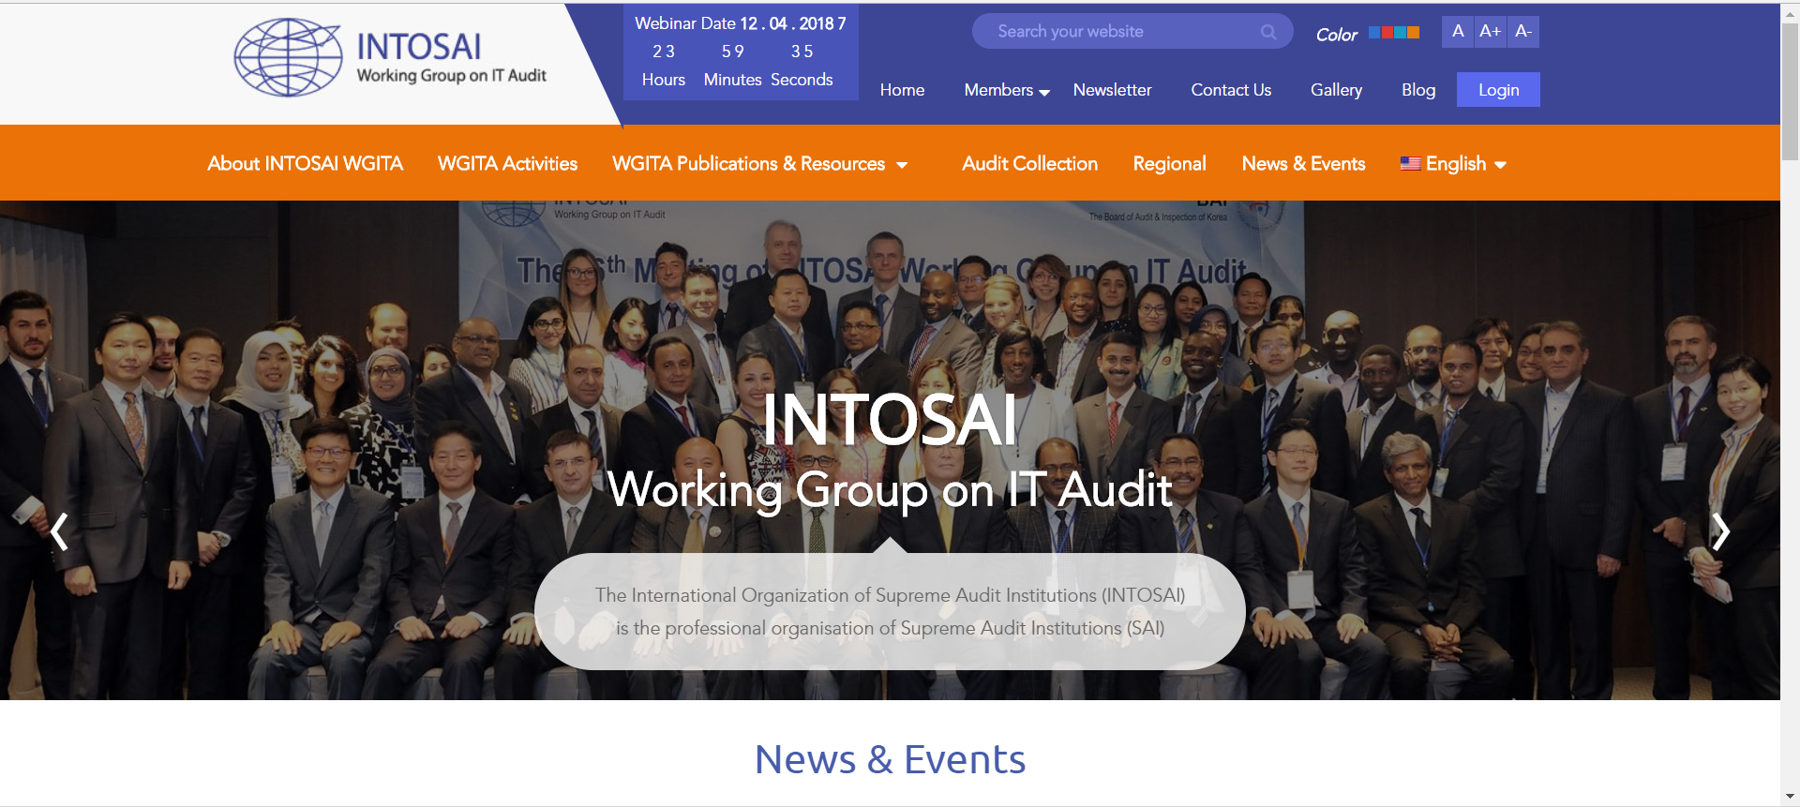
WGITA website first look

Slide 7
Thank You

